Slide 1
Project: Lending club loan
 | Outline
1 | Background
2 | Model Insights
3 | Model Approach
4 | Conclusion
5 | Next Step
6 | Acknowledge
7 | Q&A

Slide 2
1.1Background
Data Source: Kaggle
Problem Statement:
Using the loan data for all loans issued in lending club through 2007-2015, determine the interest rate and interest rate category for each case.
Hypothesis:
The higher the annual income, higher grade, the lower interest rate will be assigned.
Approach and models:
interest rate ( continuous): OLS regression
interest rate category( categorical): KNN, Decision Tree, Random Forest

Slide 3
2.1 Model insights: Data Step Summaries
# step 1: Acquire data
# step 2: Mine the data (variable selection)
step2.1 get the overview-snapshot,shape,describe
step2.2 get the checklist of graphs: density, hist, boxplot, scatter, crosstab
step2.3 deal with the missing value and duplicates
# Step 3: Parse the data
step3.1 generate the correlation matrix
step3.2 create new variables- dummy or consolidate
step3.3 generate the data for modeling
# step 4: Build the model
step4.1 OLS for continuous variable: int_rate (R ^2, MSE)
step4.2 KNN for categorical variable: int_rate_cate (Accuracy rate, AUC)
step4.3 Decision Tree for ..(AUC)
step4.4 Random Forest for ..(AUC)

Slide 4
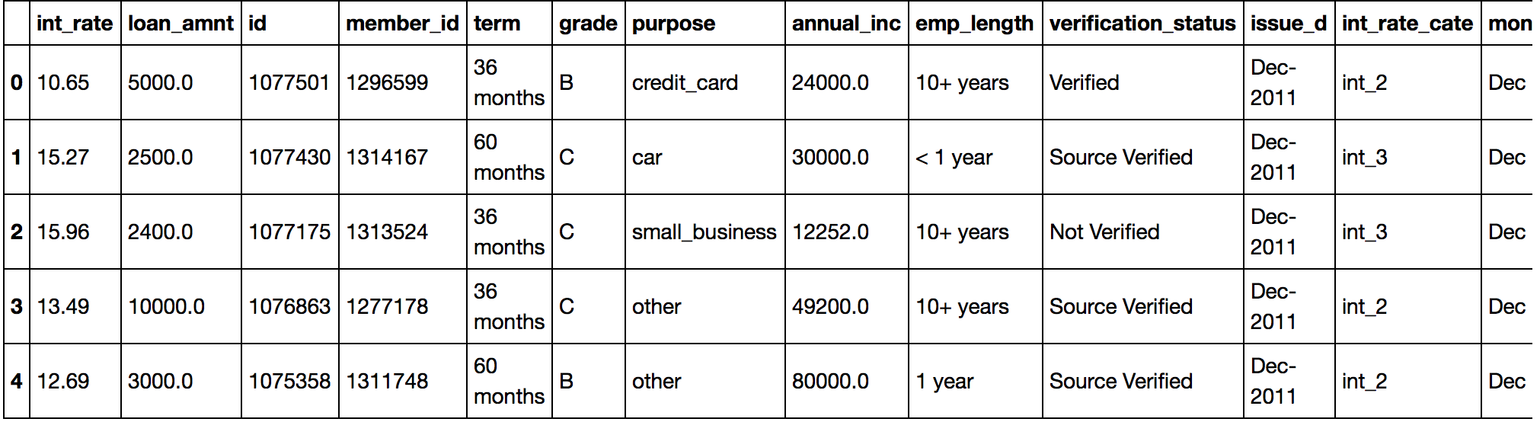
2.2 Model Insights
Data snapshot:
Data shape
Variable selection and exclude outlier
(887379 , 74) ==== > (867304, 22)

Slide 5
2.3 Model Insights: annual_income
Insights:
there are some outliers that drag the distribution of annual income very steep.
Filter by annual_income > $200,000. The rows goes from 887,379 to 867,304. however, has a nicer distribution

Slide 6
2.4 Model Insights – length of employment
Insights:
even though most of them have more than 10 years working experience, but the average interest rate among group are similar. => exclude this variable.

Slide 7
2.5 Model Insight: Purpose
Insights:
The number of debt consolidation is largest; The average interest rate for small business is highest
New variable => three level => debt consolidation, small business, others.

Slide 8
2.6 Model Insights: Label- Interest rate
Summary:
mean 13.246740
std 4.381867
min 5.320000
25% 9.990000
50% 12.990000
75% 16.200000
max 28.990000
Generate new label:
Int_1: 5% - 10%
Int_2: 10% - 15%
Int_3: > 15%
Insights:
Transform interest rate into categorical variable

Slide 9
3. Model- overview
Raw Data
(887,379 74)
Clean Data
(867,304 8)
No. | Feature Name | Label Name | Model | Metrics
1 | Loan Amount | Interest Rate ( continuous) | OLS | R^2, AIC
2 | Annual Income | Interest Rate ( Categorical) | KNN, Decision Tree, Random Forest | Accuracy, AUC
3 | Verification Indicator
4 | Grade
5 | Purpose
6 | Terms

Slide 10
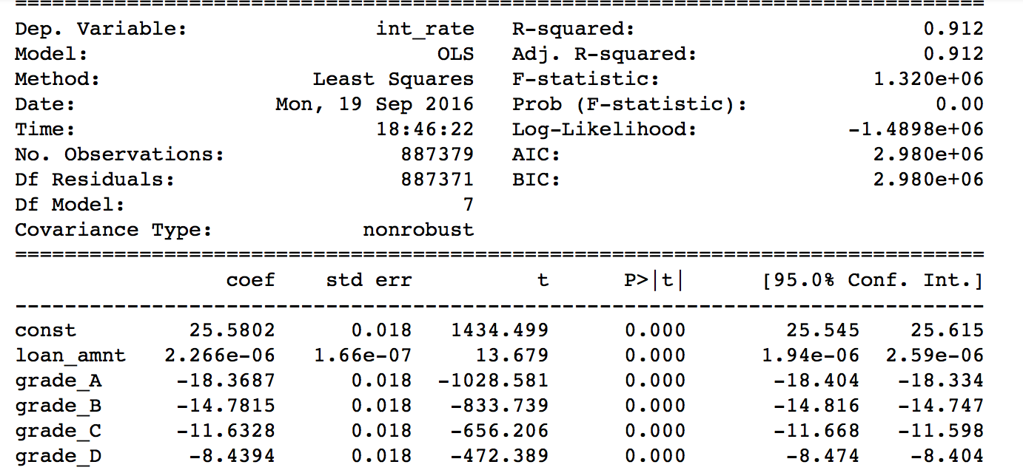
3.1 Model1 OLS
Features: 'loan_amnt’, ‘grade’
Label: Inter_rate_cate
Insights:
R square is 0.912
AIC is 2980000

Slide 11
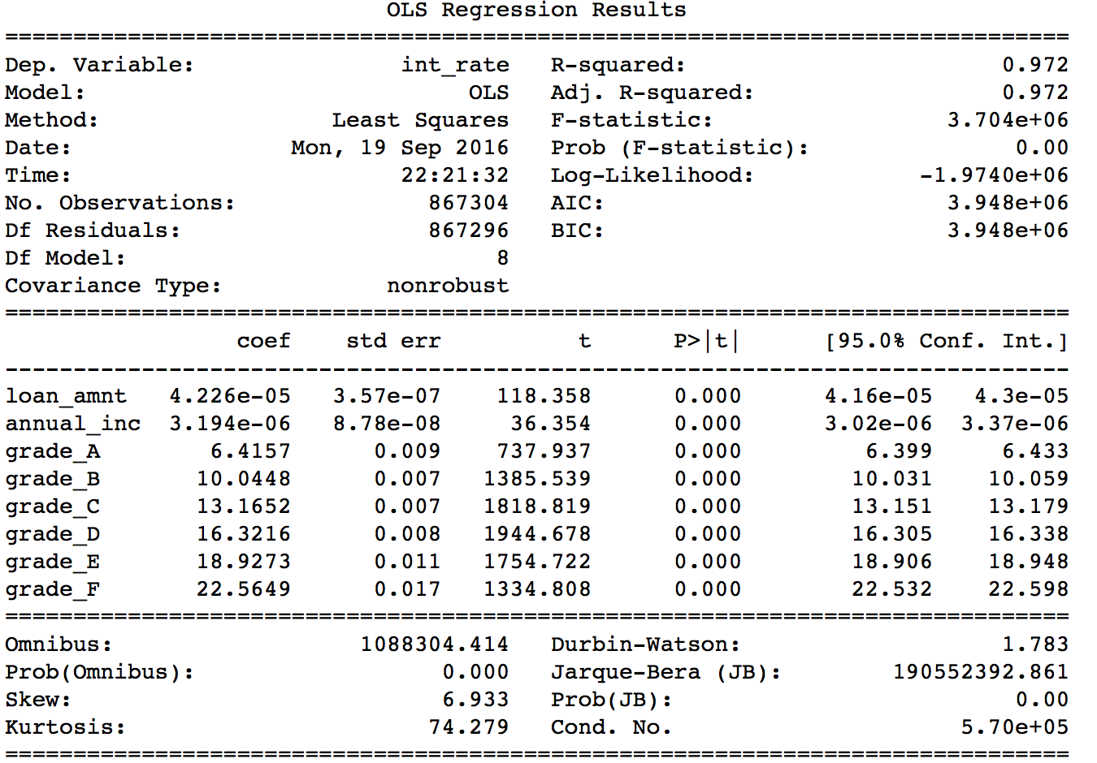
3.1 Model1 OLS
Features: 'loan_amnt','grade’, ‘annual_income”
Label: Inter_rate_cate
Insights:
R square is 0.972
AIC is 3948000
Better result

Slide 12
3.2 Model : KNN
Model1
X: Loan amount, grade
Accuracy:
82.98%
Model2
X: Loan amount, grade, annual income
Accuracy: 77.40%

Slide 13
3.3 Model : Decision Tree
X: annual_income, grade, loan amount
Y: interest rate category
Accuracy: 84.45%

Slide 14
3.3 Model Random Forest
X: annual_income, grade, loan amount
Y: interest rate category
N_tree = 5
Grid search: n_trees = 5,6,7,8,9
Accuracy Comparison
 | Features | Importance
2 | Grade A | 0.295300
4 | Grade C | 0.202875
5 | Grade D | 0.151593
3 | Grade B | 0.116861
1 | Annual_inc | 0.081658
Accuracy: 82.32%

Slide 15
4 Conclusion
Grade, Annual Income, Loan Amount are good predictors for interest rate
Strengths:
Utilize different models and tune the parameters to get best model
Best accuracy is 84,45%
Limitations:
cannot show the AUC for KNN, Decision Tree and Random Forest due to multi-class
Grade may be highly correlated with interest rate by default
For KNN, the scale of income and loan amount is big, compared to interest rate

Slide 16
5 Next step
Use Grid search for search for the best n_trees for random forest
Standardize the income and loan amount for KNN, to further increase the accuracy
Come up with metrics to replace AUC
Perform time series analysis

Slide 17
6 Acknowledge
General Assembly
Sri Kanajan
Dan Grigoras
Everyone in the Data Science Class

Slide 18
Q & A

